Slide 1
Grow Right 2.0: Программа поощрения роста партнеров в отношении стратегических решений (GGM)
1 April 2014

Slide 2
Grow Right: Компенсация за рост
Увеличивай доход и получай за это рибейты!
Программа доступна Platinum, Gold, Silver and Expert партнерам
10% rebate от прироста по Бонусным Решениям YoY
Действует с 01 апреля 2014
Notes:
Avaya Grow Right is a financial program for every Avaya Connect Medal Partner and expert partners
It applies to every Platinum, Gold and Silver partners, and to Authorized SME Expert partner.
To be eligible for the program partner needs to be Avaya Connect “Partner in a good standing”, and in-line with the Avaya Connect Solution Authorization, and Minimum channel requirement policy.
This program is built to provide value to those partners committed in strategic Avaya solution, and provides a cash benefit, which is a competitive advantage. It will provide a high value for being an Avaya partner.
Solutions participating in the program are those providing high margin and high strategic value. Full list is available on the Avaya Connect portal, and on the slide at the end of this presentation.

Slide 3
1. Основные положения программы
Оборот партнера по бонусным решениям должен увеличиться не менее чем на минимальный процентный порог. Результат Q3 FY14 сравнивается с результатом Q3 FY13
Общий оборот партнера за квартал должен увеличиться не менее чем на $1
Solution Set | Rebate % by Solution Set | Minimum YoY Growth Requirement
SME: | 10% | 20%
Networking: | 10% | 25%
Scopia: | 10% | 50%
UC: | 10% | 20%
CC: | 10% | 20%
Total Avaya Rewenue |  | 1%
Notes:
There is no enrollment request, every partner will be automatically part of the program if they meet the criteria.
- They need to be Medal or SME Expert
- Avaya Connect partner in a good standing
- Solution authorized and in line with the minimum channel requirement
There will be a check every end of quarter and every partner, who got promoted to a medal level or got an expert badge, that will become eligible for the program will enter in the program and have its baseline set.
Rebate is payable if the Q/Q grow is 10% or above and total Avaya revenue is minimum 1$ greater Q/Q
There is no need to claim the rebate, it will be paid automatically 90 days after the end of the quarter via EFT, the same process of the MDF
Program is stackable with other program or incentive

Slide 4
2. Основные положения программы
Участвуют только продукты (сервисы не участвуют)
Notes:
There is no enrollment request, every partner will be automatically part of the program if they meet the criteria.
- They need to be Medal or SME Expert
- Avaya Connect partner in a good standing
- Solution authorized and in line with the minimum channel requirement
There will be a check every end of quarter and every partner, who got promoted to a medal level or got an expert badge, that will become eligible for the program will enter in the program and have its baseline set.
Rebate is payable if the Q/Q grow is 10% or above and total Avaya revenue is minimum 1$ greater Q/Q
There is no need to claim the rebate, it will be paid automatically 90 days after the end of the quarter via EFT, the same process of the MDF
Program is stackable with other program or incentive

Slide 5
3. Основные положения программы
Общая сумма бонуса не может быть выше $150K
Notes:
There is no enrollment request, every partner will be automatically part of the program if they meet the criteria.
- They need to be Medal or SME Expert
- Avaya Connect partner in a good standing
- Solution authorized and in line with the minimum channel requirement
There will be a check every end of quarter and every partner, who got promoted to a medal level or got an expert badge, that will become eligible for the program will enter in the program and have its baseline set.
Rebate is payable if the Q/Q grow is 10% or above and total Avaya revenue is minimum 1$ greater Q/Q
There is no need to claim the rebate, it will be paid automatically 90 days after the end of the quarter via EFT, the same process of the MDF
Program is stackable with other program or incentive

Slide 6
4. Основные положения программы
Наличие бизнес плана в SFDC – ОБЯЗАТЕЛЬНО !!!
Notes:
There is no enrollment request, every partner will be automatically part of the program if they meet the criteria.
- They need to be Medal or SME Expert
- Avaya Connect partner in a good standing
- Solution authorized and in line with the minimum channel requirement
There will be a check every end of quarter and every partner, who got promoted to a medal level or got an expert badge, that will become eligible for the program will enter in the program and have its baseline set.
Rebate is payable if the Q/Q grow is 10% or above and total Avaya revenue is minimum 1$ greater Q/Q
There is no need to claim the rebate, it will be paid automatically 90 days after the end of the quarter via EFT, the same process of the MDF
Program is stackable with other program or incentive

Slide 7
5. Основные положения программы
Для участия в программе требуется регистрация (Q4 до 15 августа 2014)
Notes:
There is no enrollment request, every partner will be automatically part of the program if they meet the criteria.
- They need to be Medal or SME Expert
- Avaya Connect partner in a good standing
- Solution authorized and in line with the minimum channel requirement
There will be a check every end of quarter and every partner, who got promoted to a medal level or got an expert badge, that will become eligible for the program will enter in the program and have its baseline set.
Rebate is payable if the Q/Q grow is 10% or above and total Avaya revenue is minimum 1$ greater Q/Q
There is no need to claim the rebate, it will be paid automatically 90 days after the end of the quarter via EFT, the same process of the MDF
Program is stackable with other program or incentive

Slide 8
6. Основные положения программы
За выполнение требования по минимальному росту по всем продуктовым линейкам предосмотрен дополнительный бонус: +3%
Notes:
There is no enrollment request, every partner will be automatically part of the program if they meet the criteria.
- They need to be Medal or SME Expert
- Avaya Connect partner in a good standing
- Solution authorized and in line with the minimum channel requirement
There will be a check every end of quarter and every partner, who got promoted to a medal level or got an expert badge, that will become eligible for the program will enter in the program and have its baseline set.
Rebate is payable if the Q/Q grow is 10% or above and total Avaya revenue is minimum 1$ greater Q/Q
There is no need to claim the rebate, it will be paid automatically 90 days after the end of the quarter via EFT, the same process of the MDF
Program is stackable with other program or incentive

Slide 9
7. Основные положения программы
Для программы Grow Right 2.0 разработана форма симуляции расчета рибейта. Партнер вместе с CAMом может расчитать ориентировочную сумму бонуса.
Notes:
There is no enrollment request, every partner will be automatically part of the program if they meet the criteria.
- They need to be Medal or SME Expert
- Avaya Connect partner in a good standing
- Solution authorized and in line with the minimum channel requirement
There will be a check every end of quarter and every partner, who got promoted to a medal level or got an expert badge, that will become eligible for the program will enter in the program and have its baseline set.
Rebate is payable if the Q/Q grow is 10% or above and total Avaya revenue is minimum 1$ greater Q/Q
There is no need to claim the rebate, it will be paid automatically 90 days after the end of the quarter via EFT, the same process of the MDF
Program is stackable with other program or incentive

Slide 10
8. Основные положения программы
Бонусы перечисляются через Burch Worldwide – Avaya MDF провайдер
Notes:
There is no enrollment request, every partner will be automatically part of the program if they meet the criteria.
- They need to be Medal or SME Expert
- Avaya Connect partner in a good standing
- Solution authorized and in line with the minimum channel requirement
There will be a check every end of quarter and every partner, who got promoted to a medal level or got an expert badge, that will become eligible for the program will enter in the program and have its baseline set.
Rebate is payable if the Q/Q grow is 10% or above and total Avaya revenue is minimum 1$ greater Q/Q
There is no need to claim the rebate, it will be paid automatically 90 days after the end of the quarter via EFT, the same process of the MDF
Program is stackable with other program or incentive

Slide 11
Примеры расчета бонусов
Partner | Link ID | Solution Set | 4QFY13 Baseline | Minimum YoY Growth Rate % Required for Rebate | Minimum 4QFY14 Purchases Required for Rebate | 4QFY14 Forecast | Rebate per Solution Set
Partner ABC | 12345 | SME | $ 228 | 20% | $ 274 | $ - | $ -
 |  | Networking | $ 29 976 | 25% | $ 37 470 | $ 170 000 | $ 14 002
 |  | Scopia | $ - | 50% | $ - | $ 90 000 | $ 9 000
 |  | UC | $ 20 576 | 20% | $ 24 691 | $ 110 000 | $ 8 942
 |  | CC | $ 52 220 | 20% | $ 62 664 | $ 260 000 | $ 20 778
 |  | Total Avaya Revenue | $ 133 720 | 1% | $ 135 057 | $ 740 000 | YES
Notes:
The calculation is easy and it starts with the baseline, in this example partner ABC have its baseline in Q1 with 11844$
In Q2 partner ABC will generate 190K$ revenue that is 179K$ grow from previous quarter above the 10%, so it is eligible for a rebate and will 35K$
Then this partner ABC is growing in Q3 and Q4 as well, always above the 10% threshold and will get a rebate payout every quarter.
Partner XYZ instead is growing Q1 vs Q2, but it is not progressing in Q3 as his revenue is declining, so a negative grow will not generate a rebate.
Then he will grow again from Q3 into Q4 but he is still not eligible for a rebate, as the baseline is not simply dropped at Q3 value but it is an average of the 2 previous quarter, that means Q1 revenue + Q1 revenue divided by 2 so the real baseline is 1463K$
That means that even in Q4 the result is below the grow, therefore no rebate.

Slide 12
Примеры расчета бонусов
Partner | Link ID | Solution Set | 4QFY13 Baseline | Minimum YoY Growth Rate % Required for Rebate | Minimum 4QFY14 Purchases Required for Rebate | 4QFY14 Forecast | Rebate per Solution Set
Partner ZXY | 54321 | SME | $ 887 | 20% | $ 1 064 | $ 1 250 | $ 47
 |  | Networking | $ 4 100 | 25% | $ 5 125 | $ 5 300 | $ 156
 |  | Scopia | $ 47 781 | 50% | $ 71 672 | $ 130 000 | $ 10 688
 |  | UC | $ 2 669 | 20% | $ 3 203 | $ 635 000 | $ 82 203
 |  | CC | $ - | 20% | $ - | $ 200 000 | $ 26 000
 |  | Total Avaya Revenue | $ 117 115 | 1% | $ 118 286 | $ 635 000 | YES
Notes:
The calculation is easy and it starts with the baseline, in this example partner ABC have its baseline in Q1 with 11844$
In Q2 partner ABC will generate 190K$ revenue that is 179K$ grow from previous quarter above the 10%, so it is eligible for a rebate and will 35K$
Then this partner ABC is growing in Q3 and Q4 as well, always above the 10% threshold and will get a rebate payout every quarter.
Partner XYZ instead is growing Q1 vs Q2, but it is not progressing in Q3 as his revenue is declining, so a negative grow will not generate a rebate.
Then he will grow again from Q3 into Q4 but he is still not eligible for a rebate, as the baseline is not simply dropped at Q3 value but it is an average of the 2 previous quarter, that means Q1 revenue + Q1 revenue divided by 2 so the real baseline is 1463K$
That means that even in Q4 the result is below the grow, therefore no rebate.

Slide 13
Подведение итогов
В течение 30 дней – подведение итогов предыдущего квартала
В течение 90 дней – выплата

Slide 15
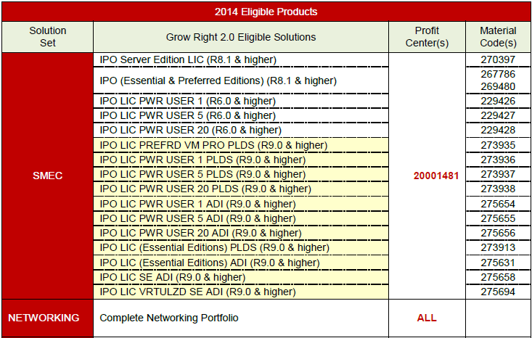
FY14 Grow Right Eligible Solutions
…Continued next slide
Notes:
List of Eligible products

Slide 16
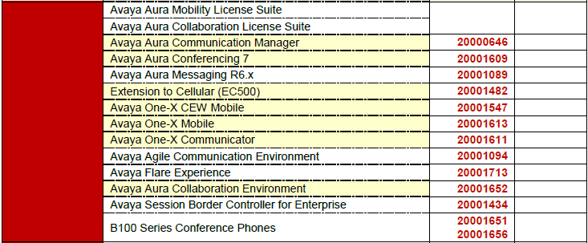
FY14 Grow Right Eligible Solutions – (cont’d)
…Continued next slide
Notes:
List of Eligible products

Slide 17
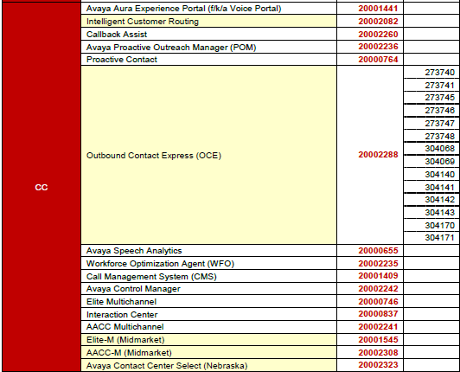
FY14 Grow Right Eligible Solutions – (cont’d)
Notes:
List of Eligible products

